Slide 1



Roydon Au | Michelle Chung | Paul Low | Luo Yiying | Timothy Chang

Slide 2

Content Outline
Roydon Au
01
Case Justification
05
Approach 1
02
Problem Statement
06
Approach 2
03
Business Opportunity
07
Live Demonstration
Improvements & Conclusion
04
Target Outcomes
08
Introduction
Integrated Solutions
Live Demonstration
Improvements
Conclusion

Slide 3
Case Justification
Roydon Au
What is LOS?
Introduction
Integrated Solutions
Live Demonstration
Improvements
Conclusion

Slide 4
Case Justification
Roydon Au
Key Implications of Inaccurate LOS
2
Operational
Financial
3
Clinical
2
1
Impaired clinical capabilities
Resources inefficiency
Stagnancy of patient throughput
Slower revenue & wasted opportunities
Inefficient patient intake
Delayed Procedures
Lesser available wards
Experiential
5
4
Health
Compromise patient experiences
Increase in the risk of infections
Insufficient LOS
Unnecessarily long LOS
Introduction
Integrated Solutions
Live Demonstration
Improvements
Conclusion

Slide 5
Case Justification
Roydon Au
African Healthcare System
1
One of the worst healthcare systems in the world
Lowest government funding in the world for health
Far behind in technology
2
Resulted in
Inadequate Human Resource
Poor Resource Allocation
Poor Healthcare Infrastructure
Raw Information
3
Raw and disorganized Information
No in-built system to guide doctors
4
Root Cause
Wide range of data that doctors are unable to process
Uninformed and Inaccurate Prescription of LOS
Introduction
Integrated Solutions
Live Demonstration
Improvements
Conclusion

Slide 6
Problem Statement
Roydon Au
Root Cause
Problem Identification
Inaccurate prescription of patient Length of Stay (LOS)
Wide range of information for doctors to process
1
Doctors neglect the efficient management of hospital resources when assessing a patient’s needs
Over prescription
Under prescription
Introduction
Integrated Solutions
Live Demonstration
Improvements
Conclusion

Slide 7
Business Opportunity
Roydon Au
Better Resource Allocation
Enhanced Inpatient Experience
Reduce wastage of resources
Better manpower allocation
Better Quality of Service
Greater Patient Flow & Reduce Waiting Time
Minimised Risk of Spread
Introduction
Integrated Solutions
Live Demonstration
Improvements
Conclusion

Slide 8
Targeted Outcomes
Timothy Chang
How Might We?
Target 1
Target 2
Develop a system to assist doctors in prescribing LOS consistently & accurately?
Determine the most significant actionable areas for Hospital Management to directly reduce unnecessary LOS?
Introduction
Integrated Solutions
Live Demonstration
Improvements
Conclusion

Slide 9

Approach 1: Consistent & Accurate LOS Prediction
Timothy Chang
Prescribe LOS consistently & accurately
Who is the target audience?
Doctors who prescribe inpatient stay to patients
What is the solution ?
What is the impact ?
Accurate Machine Learning-Generated Predictions of LOS to guide doctors' decisions
Minimize under / over-prescription of LOS
Efficient macro-managing of inpatient stay
Interactive Hospital Management Dashboard for comprehensive overview of data
2
2
Introduction
Integrated Solutions
Live Demonstration
Improvements
Conclusion

Slide 10
Approach 1: Consistent & Accurate LOS Prediction
Timothy Chang
Predictive Modelling Approach
Data Preparation
Machine Learning
Evaluation
Multi-Adaptive Regression Splines
Hospital Inpatient Data
Classification and Regression Tree (CART)
Selected Best Model
Random Forest
Introduction
Integrated Solutions
Live Demonstration
Improvements
Conclusion

Slide 11
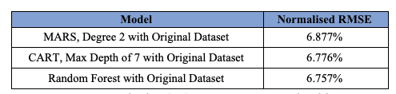
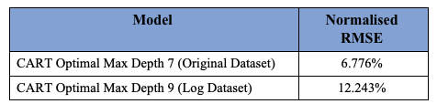
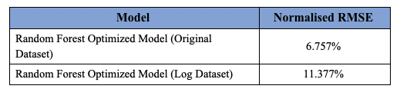
Approach 1: Consistent & Accurate LOS Prediction
Timothy Chang
Comparison of Predictive Models
Model | Normalised RMSE
MARS Degree 1 (Original Dataset) | 7.484%
MARS Degree 2 (Original Dataset) | 6.877%
MARS Degree 1 (Log Dataset) | 12.918%
MARS Degree 2 (Log Dataset) | 11.657%
Introduction
Integrated Solutions
Live Demonstration
Improvements
Conclusion

Slide 12
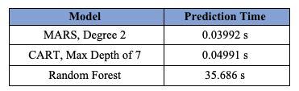
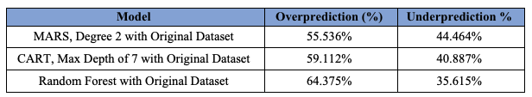
Approach 1: Consistent & Accurate LOS Prediction
Timothy Chang
Evaluation of Model
Prediction Accuracy
Explainability
Ease of Implementation
Differentiation Strategy
Functonal-level strategy
RMSE
Cart
MARS
Random Forest
All models perform better than accuracy benchmark of 9.524%
Simple
Complex
2
Overprediction / Underprediction
Ease of understanding of the model
Have a minimal impact in a clinical situation
Underprediction holds a greater implication than overprediction
Introduction
Integrated Solutions
Live Demonstration
Improvements
Conclusion

Slide 13
Approach 1: Consistent & Accurate LOS Prediction
Timothy Chang
Model of Choice
Lower Required Processing Power
Comparable Accuracy with Random Forest
CART
Greater Explaining Power
Gentler Learning Curve
Introduction
Integrated Solutions
Live Demonstration
Improvements
Conclusion

Slide 14
Approach 1: Consistent & Accurate LOS Prediction
Timothy Chang
Interactive Dashboards for Doctors
Dashboard
Use Cases
Support doctor's decision making beyond numerical predictions by CART
Non-Technical Overview of Patient Status
Length of Inpatient Stay
Surgical Procedures
Severity of Illness
Discharge or Transfer Plans
Reference when making Ward Rounds
Introduction
Integrated Solutions
Live Demonstration
Improvements
Conclusion

Slide 15

Approach 2: Targeting unnecessary LOS
Paul Low
Identify priority areas to reduce unnecessary LOS
Who is the target audience?
Hospital
management
What is the solution ?
What is the impact ?
1
To prepare an accurate CART model with significant actionable variables
1
Helps identify specific target areas to rectify
Ensures efficient resource allocation & faster decision making
Use of Dashboard to enhance explainability
Identify potential bottle necks
2
2
Introduction
Integrated Solutions
Live Demonstration
Improvements
Conclusion

Slide 16
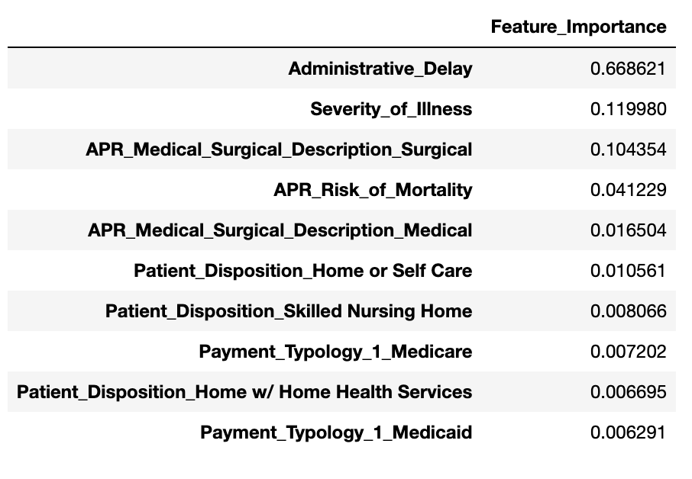
Identify priority areas to reduce unnecessary LOS
Paul Low
Variable Importance
Directs hospitals to channel resources towards significant actionable areas to reduce unnecessary LOS
Medical + Administrative Variables
Most significant variable in predicting the LOS
Top 3 problems: Paper-based, Analogue data & Information collection methods
Serve as a pivotal cause of Administrative Delay
Introduction
Integrated Solutions
Live Demonstration
Improvements
Conclusion

Slide 17
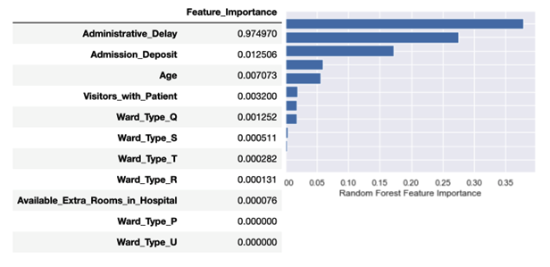
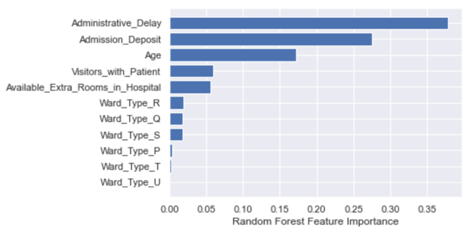
Identify priority areas to reduce unnecessary LOS
Paul Low
Variable Importance
Actionable Variables
RMSE
Model with all predictors | 6.776%
Model with the subset of predictors | 7.408%
Feature Importance across CART and Random Forest are consistent
Administrative Delay is still the most significant variable
Other variables also play a role in influencing LOS
Introduction
Integrated Solutions
Live Demonstration
Improvements
Conclusion

Slide 18
Identify priority areas to reduce unnecessary LOS
Paul Low
Interactive Dashboard for Hospital Management
Dashboard
Use Cases
Non-Technical Overview of Facilities
Mode of Payment
Availability of Extra Rooms
Department
Relevant Information for potential bottlenecks and target areas (Administrative delay)
Objective:
User-Friendly Interface for Consolidated Facilities Information
Introduction
Integrated Solutions
Live Demonstration
Improvements
Conclusion

Slide 19

Live Demonstration
Michelle Chung
Hospital Dashboard
Patient Dashboard
Introduction
Integrated Solutions
Live Demonstration
Improvements
Conclusion

Slide 20
...interesting findings from dashboard that hospital could act on.
Luo Yiying
Possible recommendation from Dashboard Findings
Spread of Patients within Wards
Inefficiencies in Transfer Processes
Observation
Observation
Patients are not split according to the severity
High delays in discharging of patients
Disorganized management process
Increase unnecessary stay in hospital
Better segmentation of their patients to prevent prolonged length of stay
Implementation of a shared discharge plan to enhance communication among caregivers
Introduction
Integrated Solutions
Live Demonstration
Improvements
Conclusion

Slide 21
Areas for Improvement
Luo Yiying
Limitations | Elaboration
Limited data on higher LOS | Data imbalance Collect more data with patients of higher stay Creating separate models for different severity types
Limited Qualitative Predictors | Some predictors were left out in our machine learning approach A time series forecast for patient inflow would value add to a hospital management’s decision making
Limited Information | Limited information for some factors Unable to analyze factors in greater detail
Manpower | Our solution facilitates the planning and allocation of resources by hospital management Limited by the amount of resources hospitals can work with
Introduction
Integrated Solutions
Live Demonstration
Improvements
Conclusion

Slide 22



Conclusion
Luo Yiying
In all..
Problem Statement
Analytics Solution
Recommendations
Inaccurate Prescription of LOS is detrimental to patients and hospitals
ML Model (CART) for consistent and accurate LOS prediction
Improve segmentation of patients to prevent prolonged length of stay
1
1
Interactive Dashboard for monitoring of significant actionable areas
2
2
Shared Discharge Plan
Introduction
Integrated Solutions
Live Demonstration
Improvements
Conclusion

Slide 23
Thank you

Slide 24
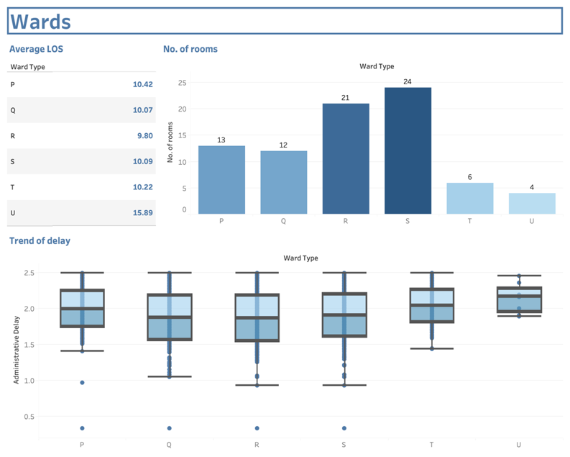
Appendix
The lower the number of available rooms per ward,
the higher the average administrative delay.
Introduction
Integrated Solutions
Improvements
Conclusion

Slide 25
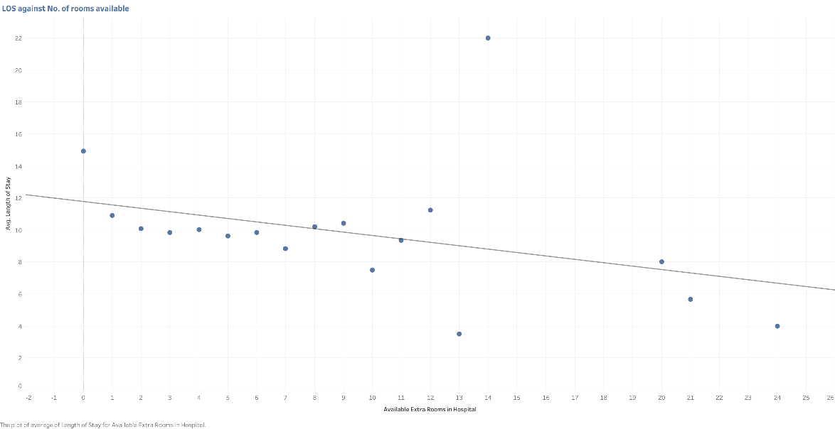
Appendix
The greater the number of available rooms per ward,
the lower the average length of stay
Introduction
Integrated Solutions
Improvements
Conclusion

Slide 26
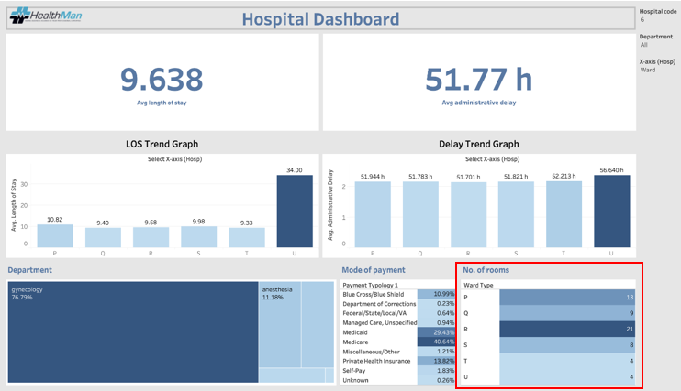
Appendix
Live Section 9.2.1 in written report
(Help doctors understand vacancy to prevent overcrowding in wards )
Introduction
Integrated Solutions
Conclusion

Slide 27
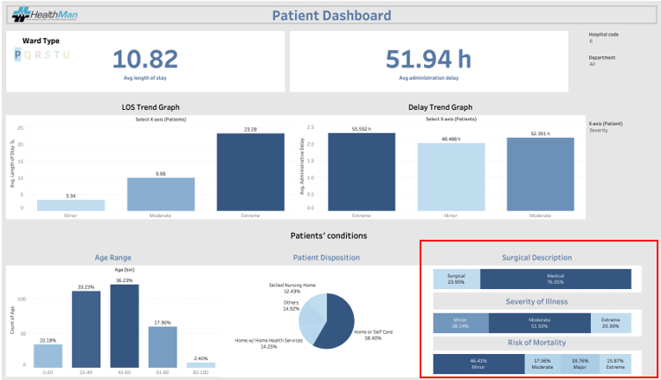
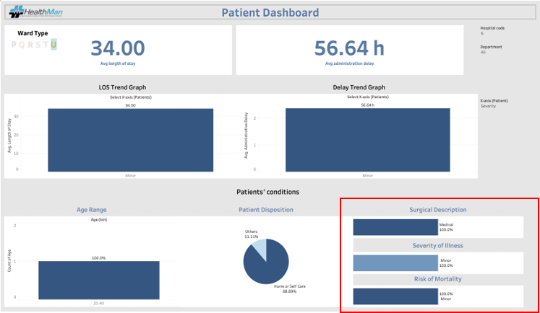
Appendix
Before
After
Live Section 9.2.1 in written report (Help doctors
understand severity spread of patients in different wards)
Introduction
Integrated Solutions
Live Demonstration
Improvements
Conclusion

Slide 28
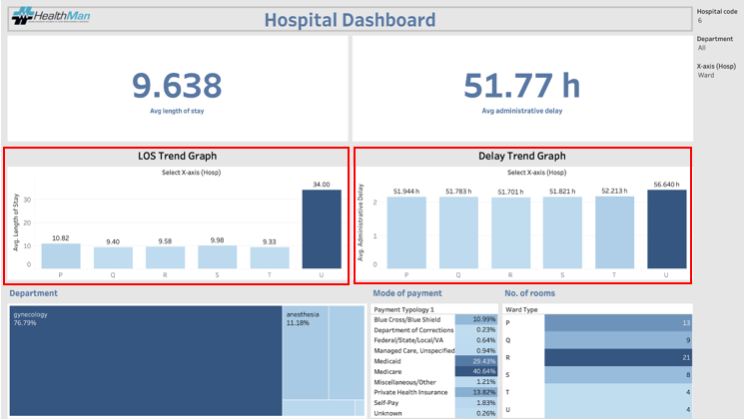
Appendix
Section 9.2.2 and 9.2.3 in written report
(Help hospital management identify high LOS/Delay, eg ward U highest LOS/Delay
Further prevents bottlenecks)
Introduction
Integrated Solutions
Live Demonstration
Improvements
Conclusion

Slide 29
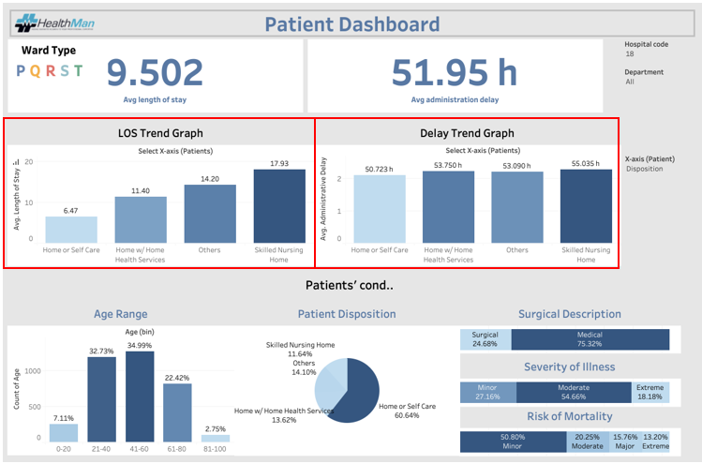
Appendix
Live Section 9.2.2 in written report
(Help hospital management target patient related processes with high LOS/Delay,
EG: Discharge to skilled nursing home has highest LOS/Admin Delay)
Introduction
Integrated Solutions
Live Demonstration
Improvements
Conclusion

Slide 30
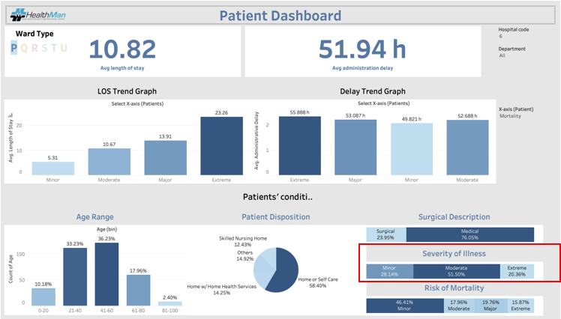
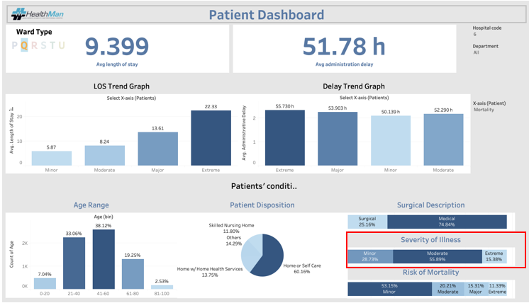
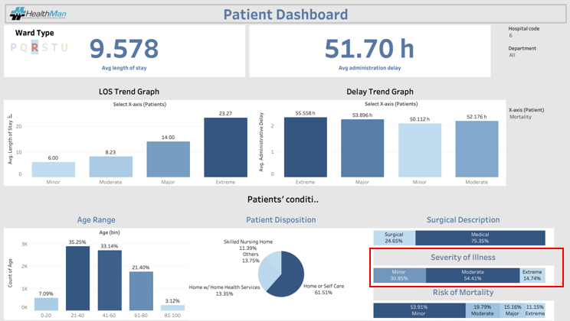
Appendix
Live Section 10.1 in written report
(Similar severity spread within different ward types
which could prolong LOS)
Introduction
Integrated Solutions
Live Demonstration
Improvements
Conclusion

